Slide 1
PON 2019-21 ISAF - Integrated Smart Assembly Factory
(Fabbrica di montaggio integrata intelligente)
OR2 – Part and Sub-assembly Measurement with Automated Robotic Systems and Variation Simulation Analysis to Compensate Part-to-Part Gap
(“Rilievo automatizzato delle geometrie e individuazione numerica e predittiva di interferenze e gap”)
Scientific Responsible: UniNa (Prof. Massimo Martorelli)
Partners: Axist, EnginSoft, Leonardo, Protom, UniNa, UniCampania, CNR, WarwickUni
Uni-Team:
UniNa: Prof. Antonio Lanzotti, Prof. Massimo Martorelli, Ing. Chris Esposito, Ing. Stefano Papa, Ing. Chiara Cosenza, Ing. Claudio Marcello, Ing. Dario Famá, Ing. Agnese Pasquariello, Ing. Castrese Di Marino, Ing. Alessandra Caggiano.
WarwickUni: Prof. Pasquale Franciosa
UniCampania: Prof. Salvatore Gerbino

Slide 2
Contents
Introduction
ISAF framework
Key Enabling Technology:
(1): in-line part measurement
(2): Virtual Shimming Simulator
(3): Shim Fabrication
Verification and Validation using Vertical Stabiliser
Results
Conclusions

Slide 3
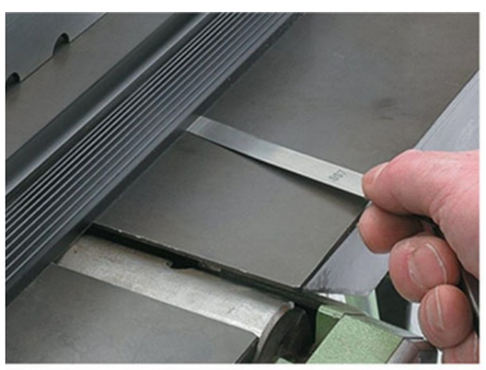
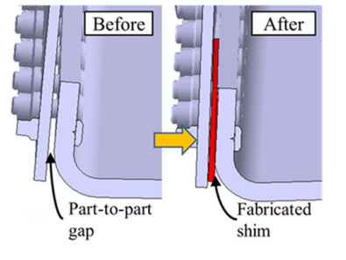
Introduction
Example of gap measurement using manual filler gauge
Positioning of shims

Slide 4
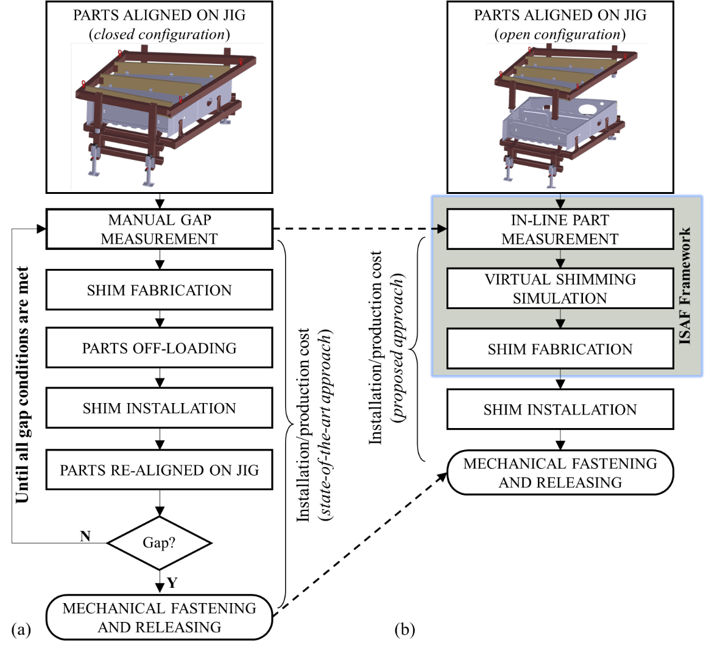
ISAF framework
State-of-the-art approach for shimming operation – closed configuration.
Proposed approach for shimming operation – open configuration.

Slide 5
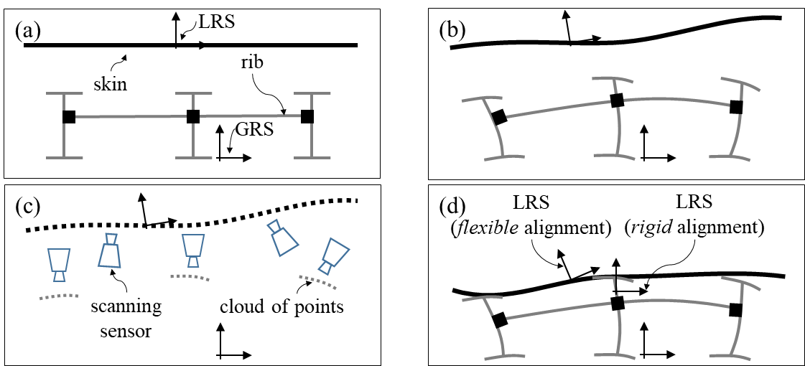
ISAF framework
(a) nominal parts; (b) actual parts; (c) in-process measurement; (d) accumulation of deviations when skin panels are moved from the open configuration to the closed configuration.

Slide 6
Key Enabling Technology (1): in-line part measurement
Work-flow of the in-line part measurement module

Slide 7
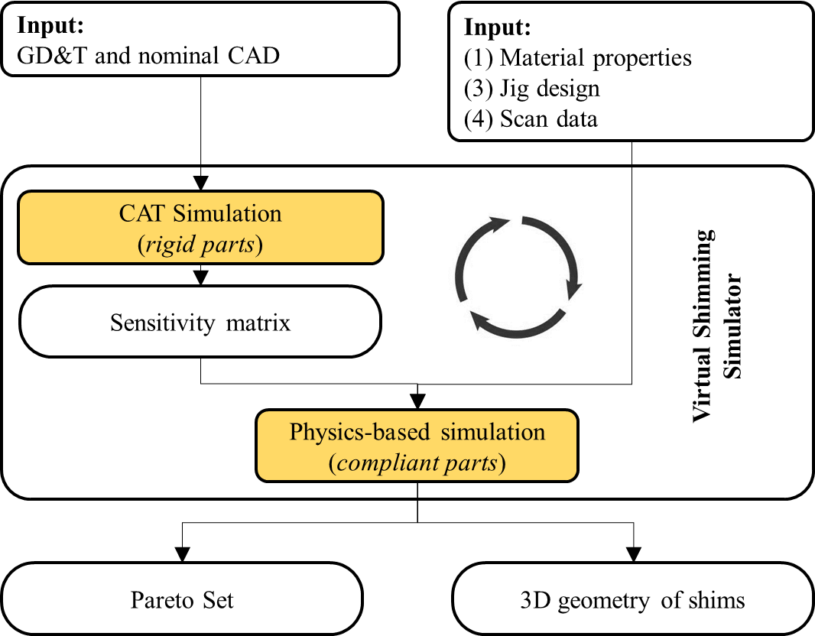
Key Enabling Technology (2): Virtual Shimming Simulator
Work-flow of the Virtual Shimming Simulator

Slide 8
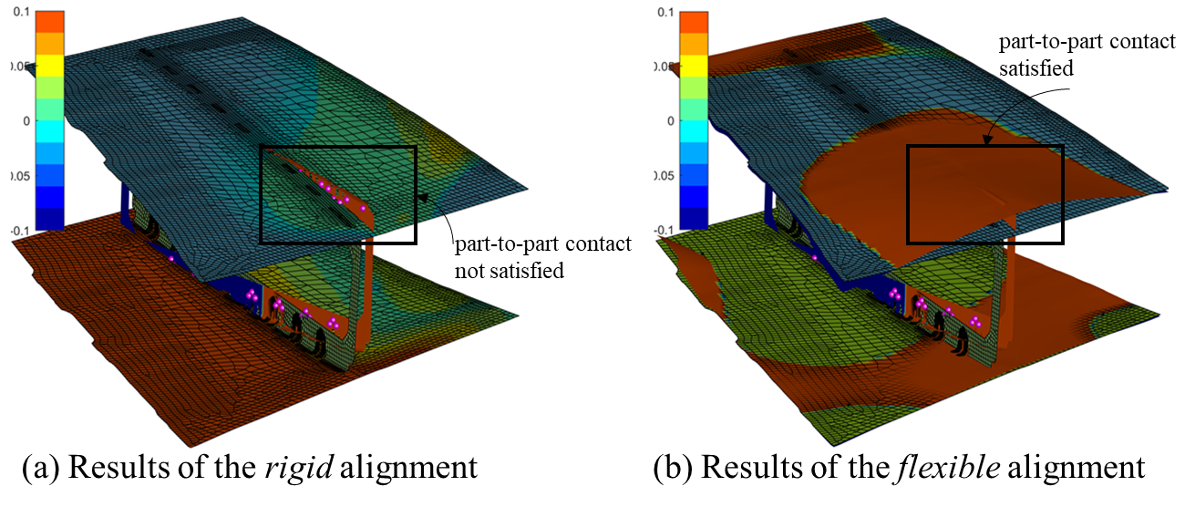
Key Enabling Technology (2): Virtual Shimming Simulator
Visualisation of rigid vs. flexible alignment on vertical stabiliser

Slide 9
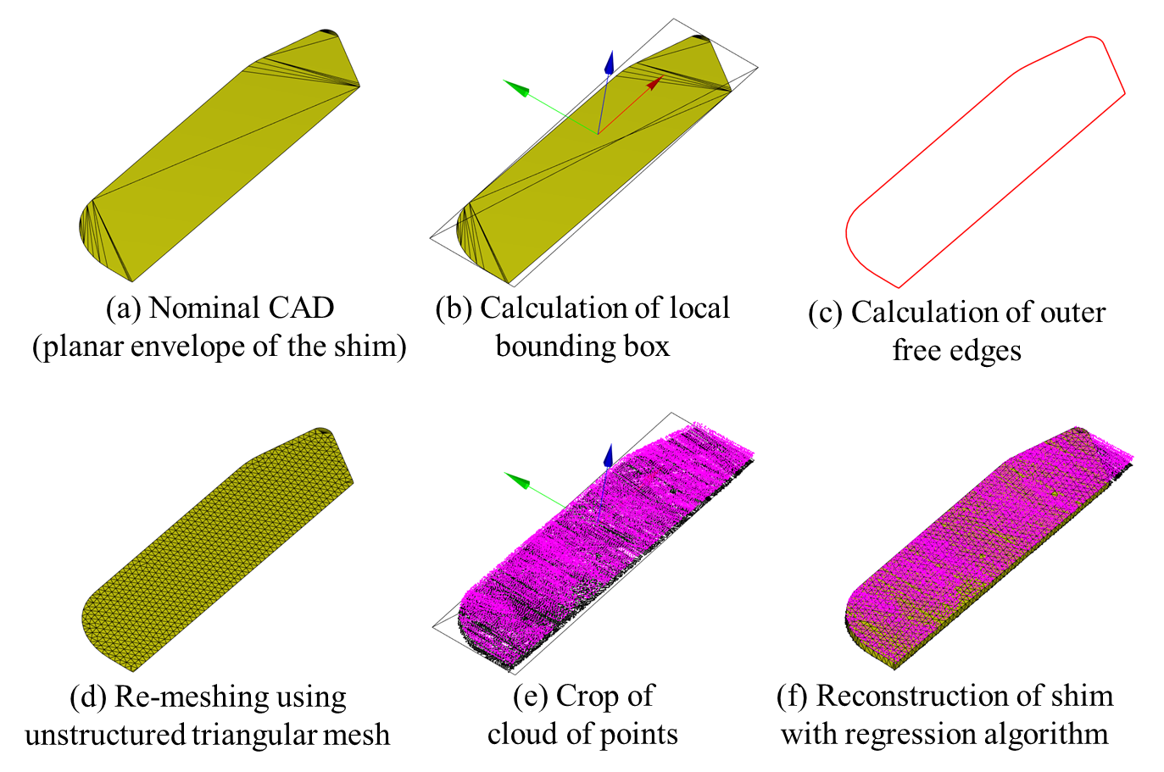
Key Enabling Technology (2): Virtual Shimming Simulator
Work-flow for generating 3D shims

Slide 10
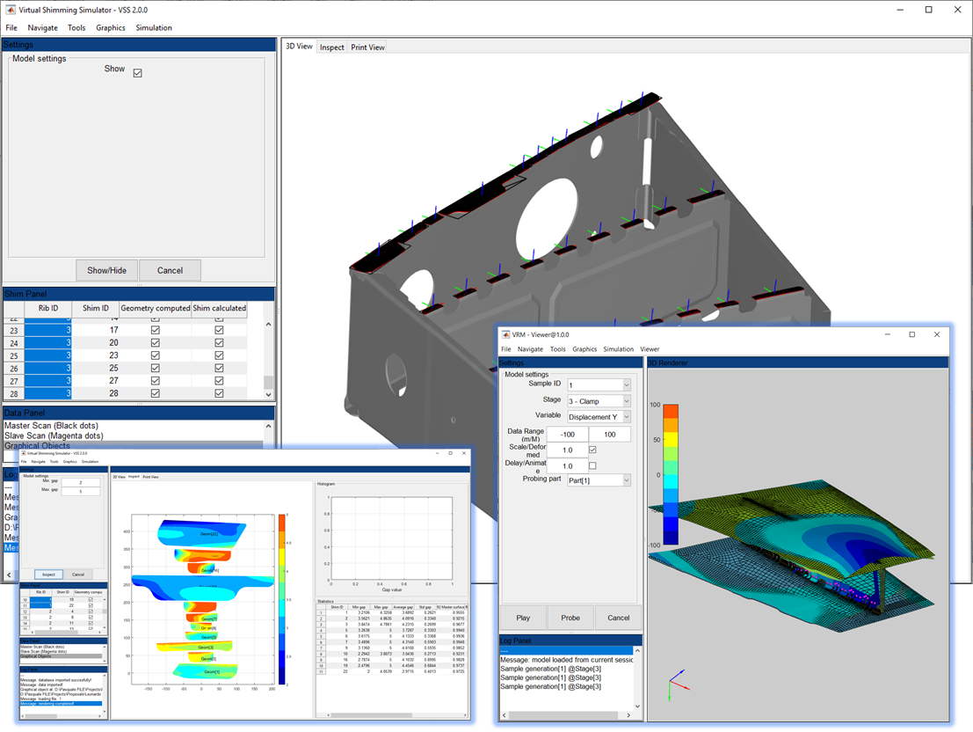
Key Enabling Technology (2): Virtual Shimming Simulator
Graphical User Interface of the Virtual Shimming Simulator

Slide 11
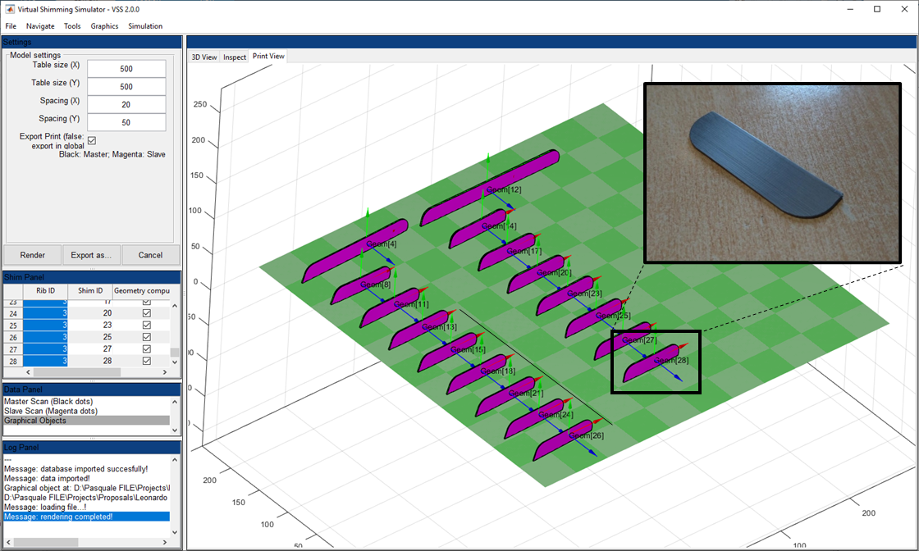
Key Enabling Technology (3): Shim Fabrication
3D printing layout with example of printed shim

Slide 12
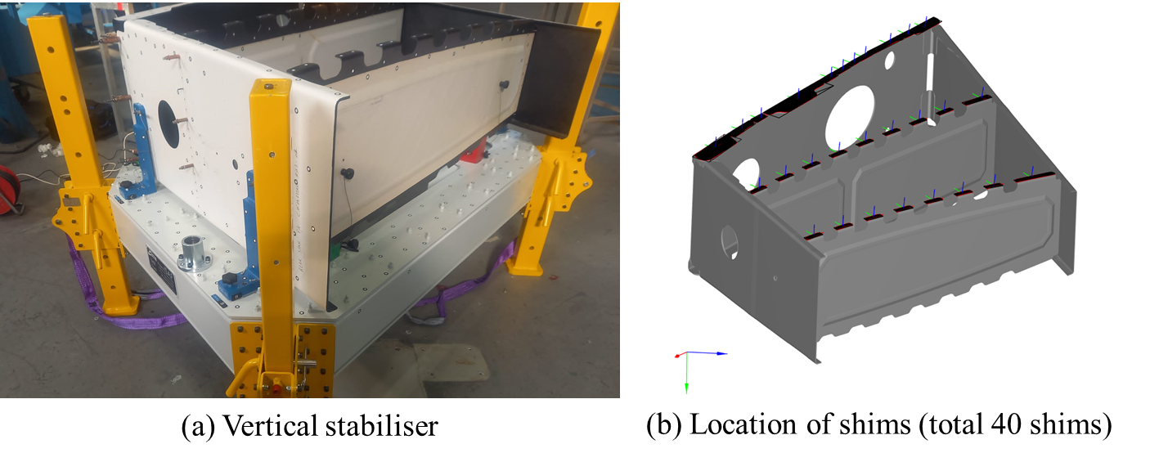
Verification and Validation using Vertical Stabiliser
Vertical stabiliser used to validate the ISAF framework

Slide 13
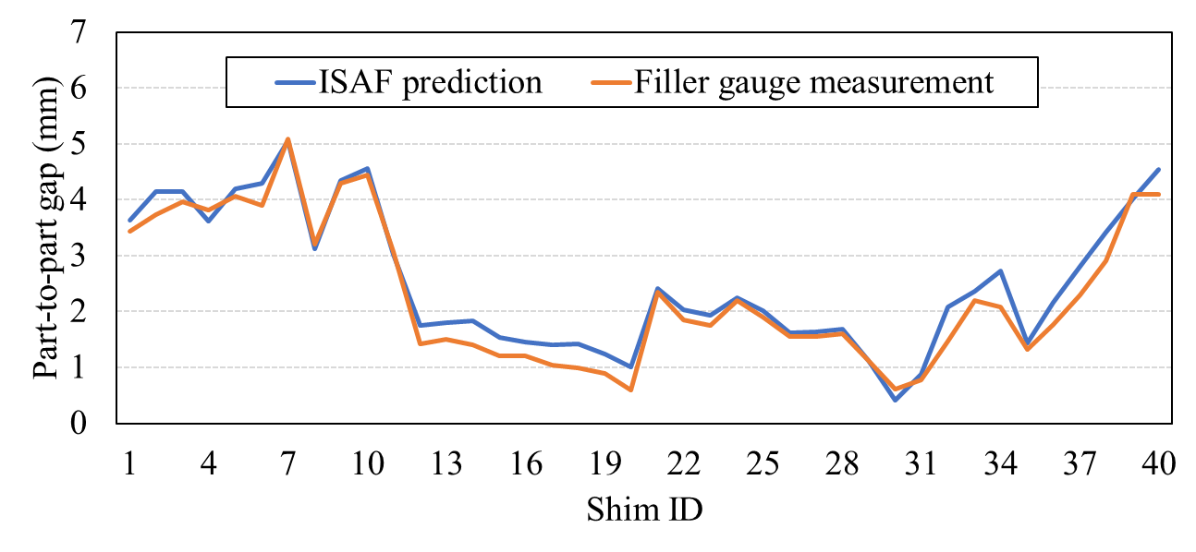
Results
Accuracy of the prediction - results are illustrated in Figure and findings show a strong correlation (approx. 98%) between the average shim thickness measured by filler gauges and predicted using the ISAF framework, with mean squared error of just 0.08 mm. This confirms the viability and accuracy of the methodology.
Time saving for measurement of part-to-part gaps – it was reported that 2 hours were spent to gather the scanned data of both ribs/spars and skin. Whereas, near 8 hours were required to collected individual measurements using manual filler gauge. This equates to a significant time saving of 75%.
Average part-to-part gap (shim thickness) measured by filler gauges
and predicted using the ISAF framework

Slide 14
Conclusions
The ISAF framework aims to transform the current manual measurement-fit-adjust quality loops into a smart process powered by smart and digital technologies such as in-line measurement systems, large-scale physics-based simulations, multi-disciplinary process optimisation and additive manufacturing.
This research will help reducing inspection and re-work costs, accelerate the adoption of digital manufacturing and drive towards the principles of zero-defects and right-first-time. Designers and manufacturing practitioners will benefit of this tool to automatically predict the part-to-part gap and will be able to “virtually” generate the 3D geometry of the shims.
The experimental validation demonstrates that the implemented digital twin approach (which can be further strengthened) offers a possible solution to the management of shimming operations in the assembly of aircraft skin panels, with a significant time saving of 75% compared to manual operations today conducted.
Upcoming research will be devoted to study and optimise the 3D printing operation in terms of accuracy and repeatability, and eventually additional cost saving.

Slide 15
Dissemination
Franciosa P., Gerbino S., Stella E., Berri L., Gramegna N., Gallo N., Martorelli M., A Digital Twin Approach for Smart Assembly of Aircraft Skin Panels with Mechanical Fasteners, Lecture Notes in Mechanical Engineering, Springer, 2022.
Esposito C., Cosenza C., Gerbino S., Martorelli M., Franciosa P., Virtual shimming simulation for smart assembly of aircraft skin panels based on a physics-driven digital twin, International Journal on Interactive Design and Manufacturing (IJIDeM), Springer, https://doi.org/10.1007/s12008-022-00875-4.
Franciosa, P., Gallo, N., Gerbino, S., Martorelli, M., Physics-based modelling and optimisation of shimming operations in the assembly process of aircraft skin panels, 2020 IEEE International Workshop on Metrology for AeroSpace, MetroAeroSpace 2020 - Proceedings, 2020, pp. 409–414.

Slide 16
PON 2019-21 ISAF - Integrated Smart Assembly Factory
(Fabbrica di montaggio integrata intelligente)
OR2 – Part and Sub-assembly Measurement with Automated Robotic Systems and Variation Simulation Analysis to Compensate Part-to-Part Gap
(“Rilievo automatizzato delle geometrie e individuazione numerica e predittiva di interferenze e gap”)
Scientific Responsible: UniNa (Prof. Massimo Martorelli)
Partners: Axist, EnginSoft, Leonardo, Protom, UniNa, UniCampania, CNR, WarwickUni
Uni-Team:
UniNa: Prof. Antonio Lanzotti, Prof. Massimo Martorelli, Ing. Chris Esposito, Ing. Stefano Papa, Ing. Chiara Cosenza, Ing. Claudio Marcello, Ing. Dario Famá, Ing. Agnese Pasquariello, Ing. Castrese Di Marino, Ing. Alessandra Caggiano.
WarwickUni: Prof. Pasquale Franciosa
UniCampania: Prof. Salvatore Gerbino
GRAZIE PER L’ATTENZIONE

