Slide 1



ISASI-NA (CNR)
PM3: OR2
Secondary propulsion system
Sergio Balestrieri, Giuseppe Coppola, Mario Iodice, Gianluigi Zito, Mario Medugno, Maurizio Casalino, Mariano A. Gioffrè

Slide 2
Secondary propulsion system
Among the various propulsion system applicable to a cubesat, the following have been selected:
Laser Ablation
Microfluidic thrust
Graphene-based propulsion
Plasmonic Propulsion
Plasmonic Propulsion:
Using the photon momentum this system don’t required on-board power (ex. Solar sail)
Compared to the solar sails, the light intensity is more concentrated and this leads to much higher strength parameters
Plasmonic Propulsion has a smaller size respect to the other secondary thruster system
Respect to the other system has lower thrust but higher precision, making them suitable for this type of function

Slide 3
Plasmonic Propulsion: Phenomenology
Electromagnetic field engineering
gradient force
radiation pressure
Metal-dielectric structure
When light and freely moving electrons (as in a metal) interact, the oscillating electric-magnetic field of the light forces the free electrons to move together with the electromagnetic oscillations.
Thus, an electron density wave is generated and the particle name of this wave is plasmon.

Slide 4
Plasmonic Propulsion: Phenomenology
Surface Plasmon Polaritons (SPP)
Localized Surface Plasmons (LSP)
SPPs are waves that propagate along the metal-dielectric interface and are highly localised, indeed the electric field in the direction orthogonal to the interface is evanescent.
LSP are non-propagating excitations of conduction electrons relative to metallic nanostructures coupled to the electromagnetic field.
SPP occur only at certain polarizations; in particular, they occur only for the TM modes
LSP allow to concentrate large amounts of energy beyond the diffraction limit
SPP are propagative phenomena
LSP are resonant phenomena
SPPs can only be generated throught some optical techniques, such as prism couplings, near field excitation etc.
LSP can be generated directly by illuminating them with monochromatic light

Slide 5
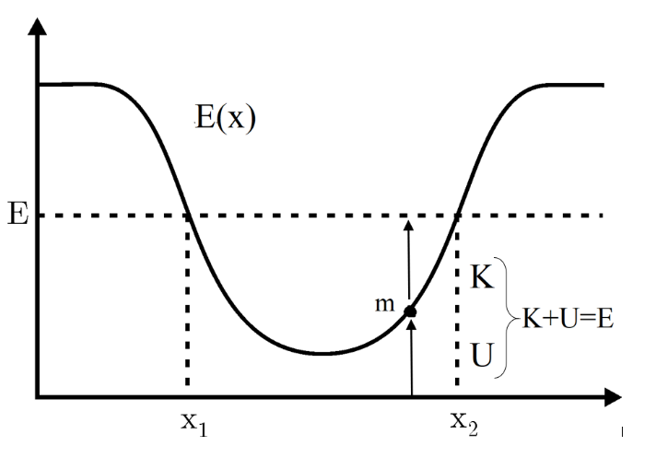
Plasmonic Propulsion: State of art
Optical Tweezers
The main application of surface plasmon is the optical tweezers, thanks to their properties of generating high intensity field in spatial areas much smaller than the diffraction limit
The nanoparticle undergoes a force caused by plasmonic excitations field that keeps it in equilibrium along a well-defined position

Slide 6
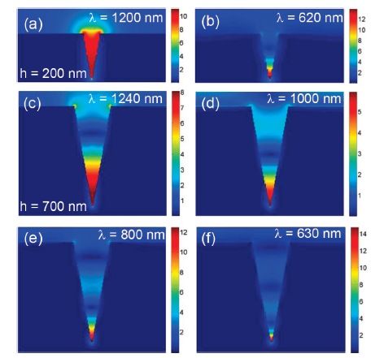

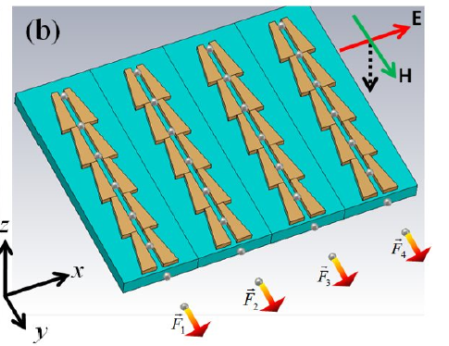
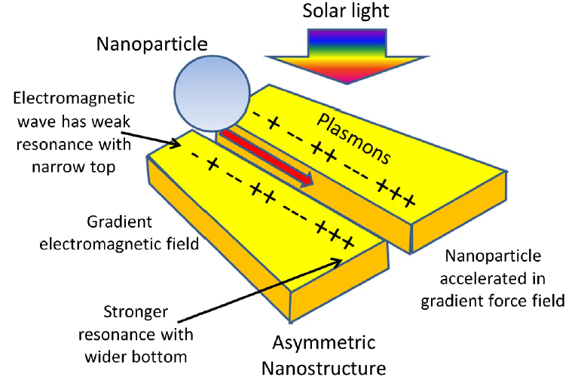
Plasmonic Propulsion: State of art
Using structures with a particular shape, it’s possible to modify the field appropriately such that the forces generate a thrust
Optical Nanocannon
[Søndergaard, et al., 2010]
In the Nanocannon a resonance is generated at a certain wavelength depending on the size of the structure and this imply the formation of SPPs that propagate and define a field distribution as in the figure
Given the type of obtained field, the resulting force generates a propulsion of nanoparticle
However, in this case the propulsion parameters are such that the ejection of particles at high speed can not be allowed
Trapezoidal asymmetric structures
[Rovey, et al., 2015]

Slide 7

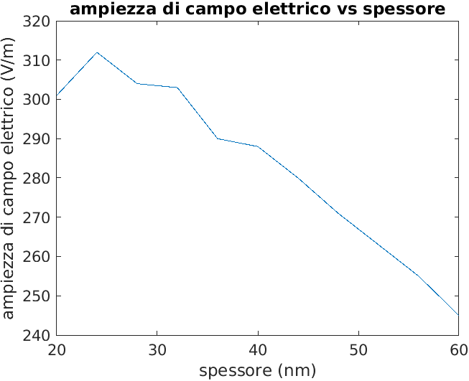
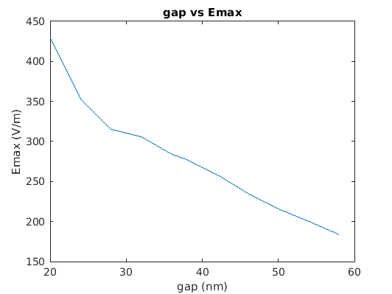
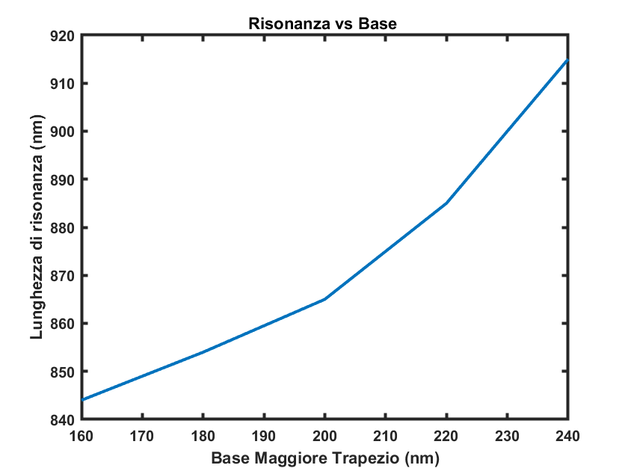
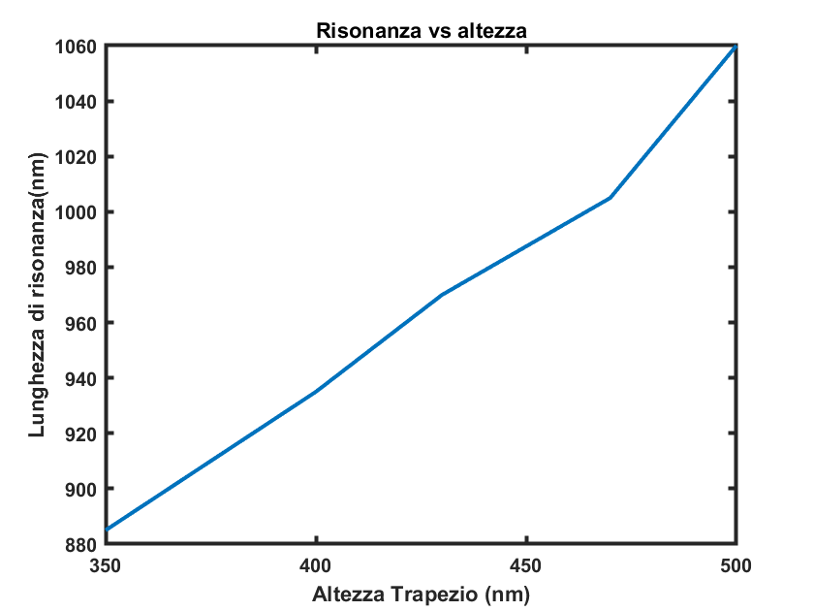
Plasmonic Propulsion System
The system consists of two gold scalene trapezoids separated by a gap and placed on a glass substrate. Once used light polarized with respect to x occurs the resonant LSP coupling with SPP generating an asymmetric electric field distribution.
Parametric Analysis
In order to optimize these trapezoidal structures on the basis of the available laser sources, an analysis was carried out based on the variation of its geometric parameters

Slide 8
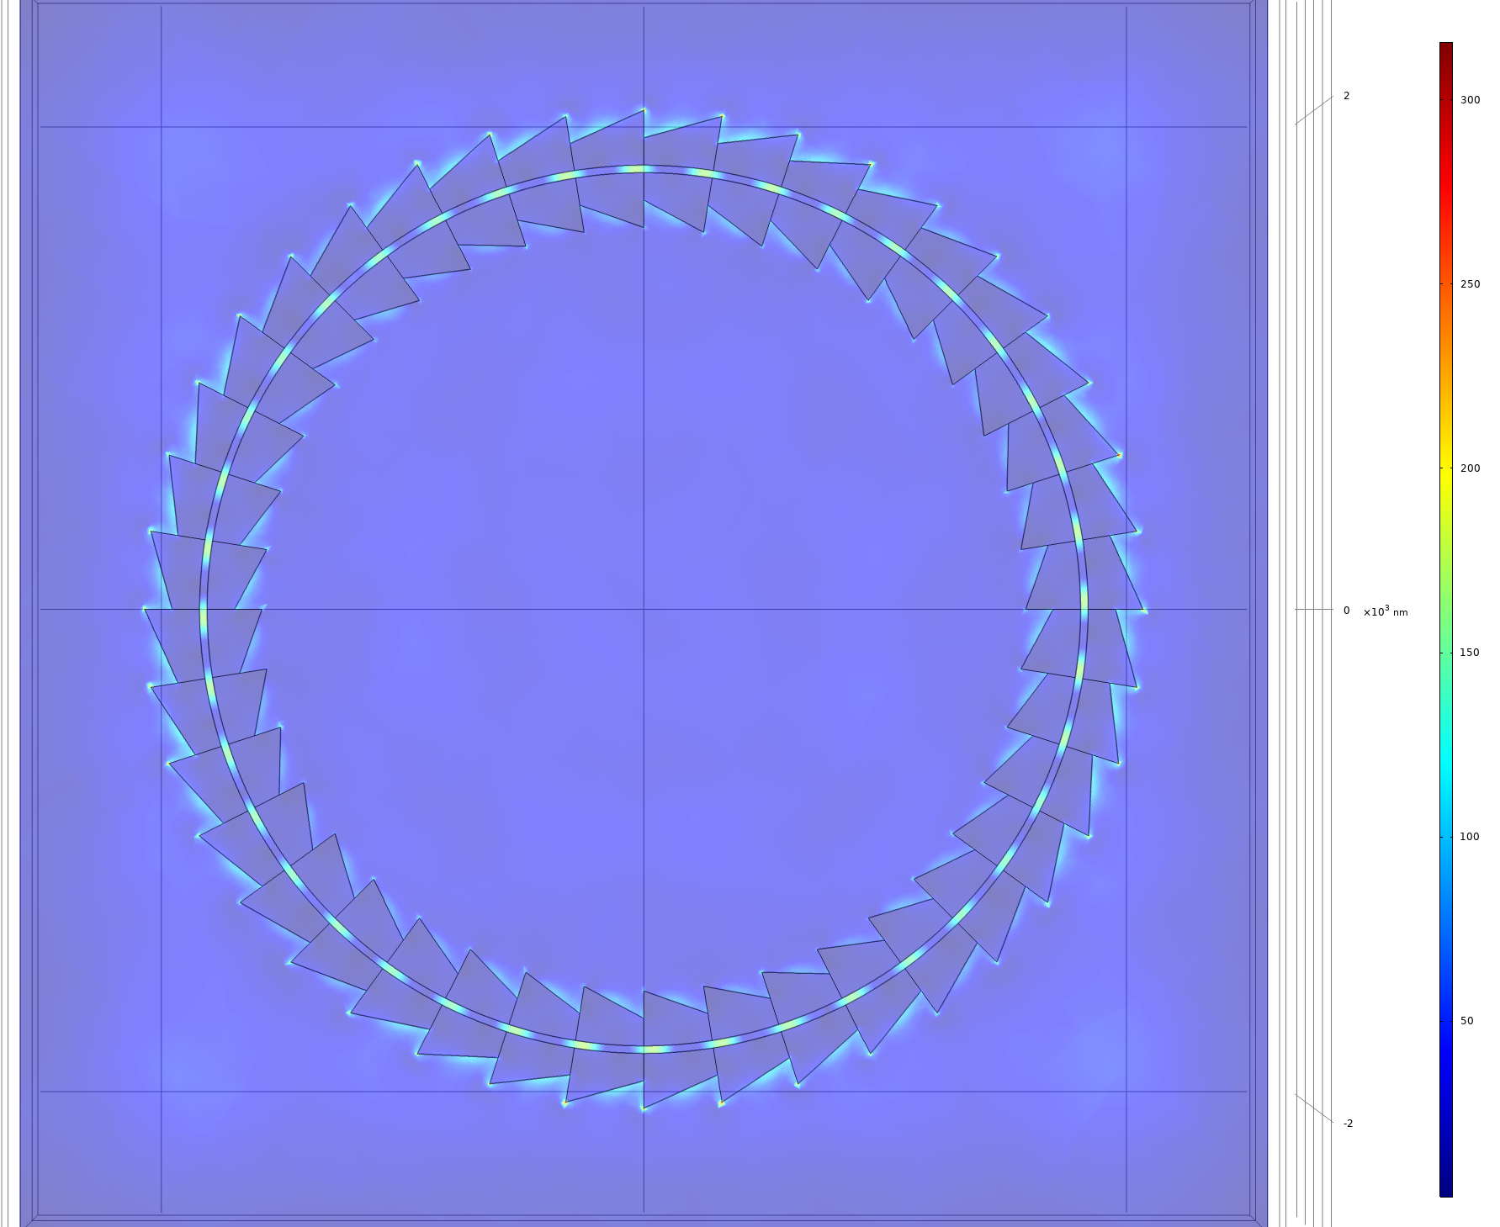
Plasmonic Propulsion: Circular Structure
In order to reduce the overall dimensions of the array and to exploit the potential of circular motion, this type of structure is being evaluated
This structure has been studied in function of the polarization of the field and of radius of the ring
Linear Y(X)-polarization
Circular polarization
Radial polarization
The optimised version has maximum values that are more than twice as high (19 V/m) as similar structures reported in the literature (8 V/m).
Compared to the case observed in the literature we note a greater monotonicity of the function which results in a reduction of the friction force which therefore causes the nanoparticle to receive greater thrusts

Slide 9
Plasmonic Propulsion: Circular Structure
Illuminating a multi serila structure with a light radiation with a wavelength coinciding with the resonance wavelength of the plasmonic structure and an optical power of 500mW, the force values expected on glass spheres with a diameter of 20nm are in the range 1-10μN.

Slide 10
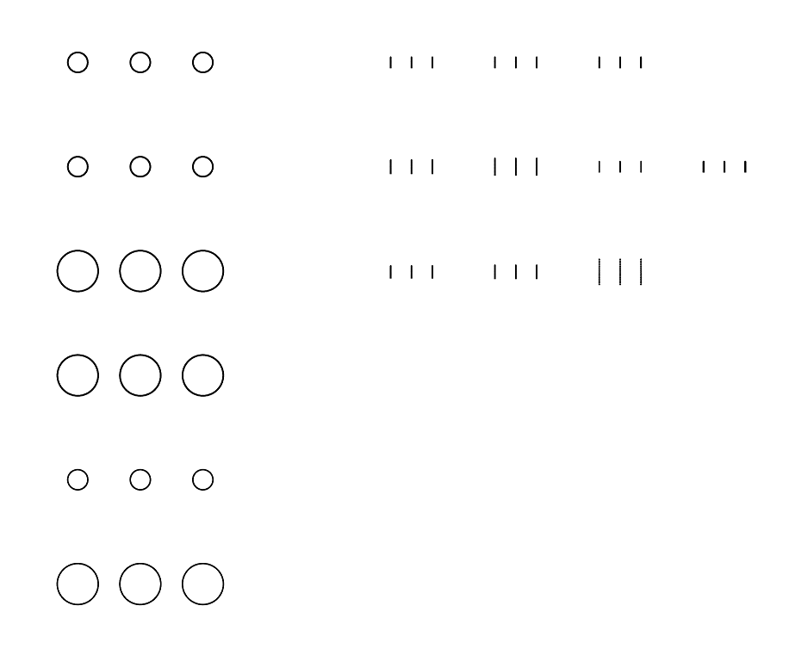

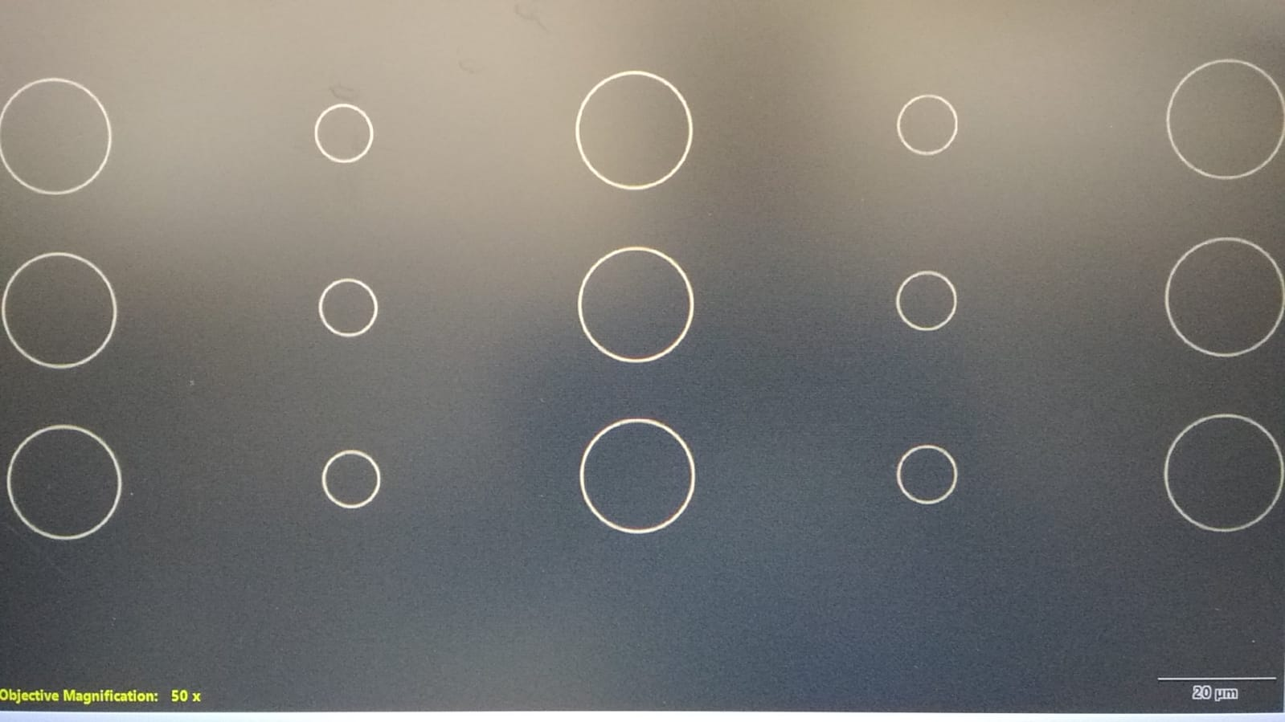
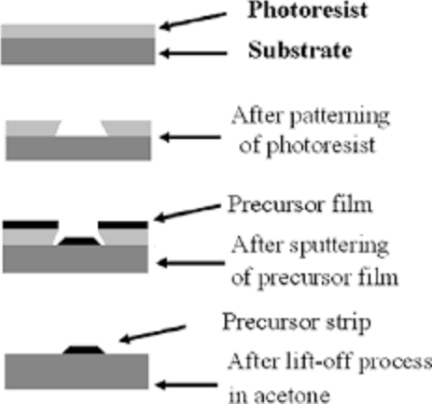
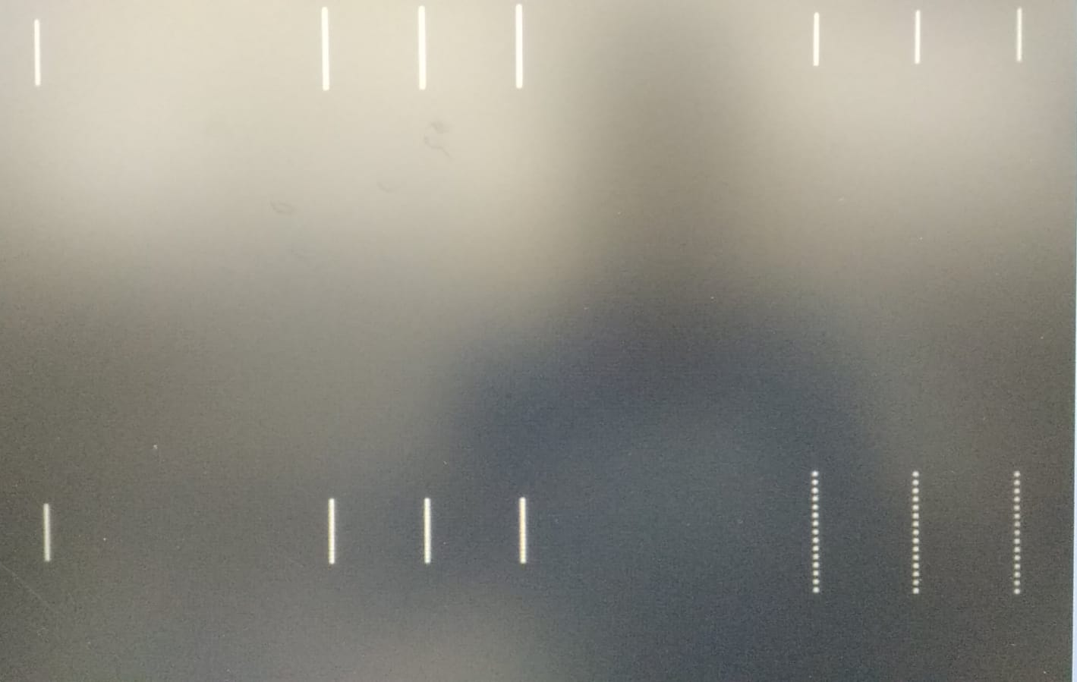
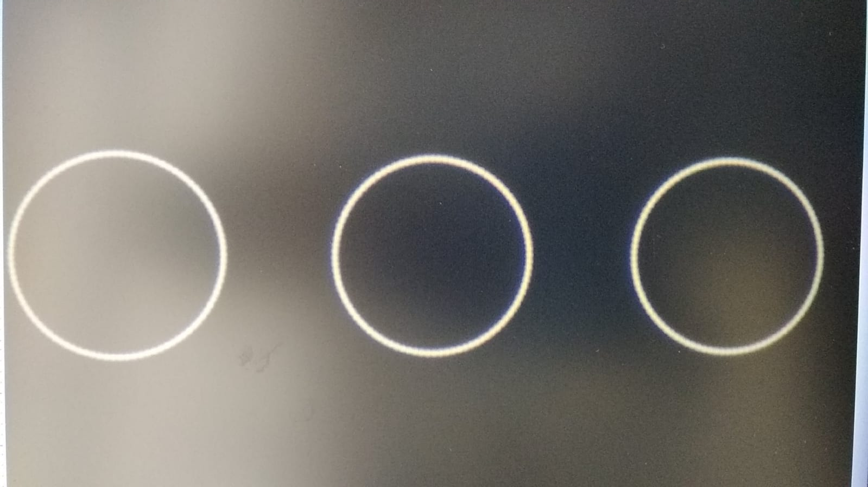
Plasmonic Propulsion: Fabrication process
State of art
Simulation
Fabrication
Characterization

Slide 11
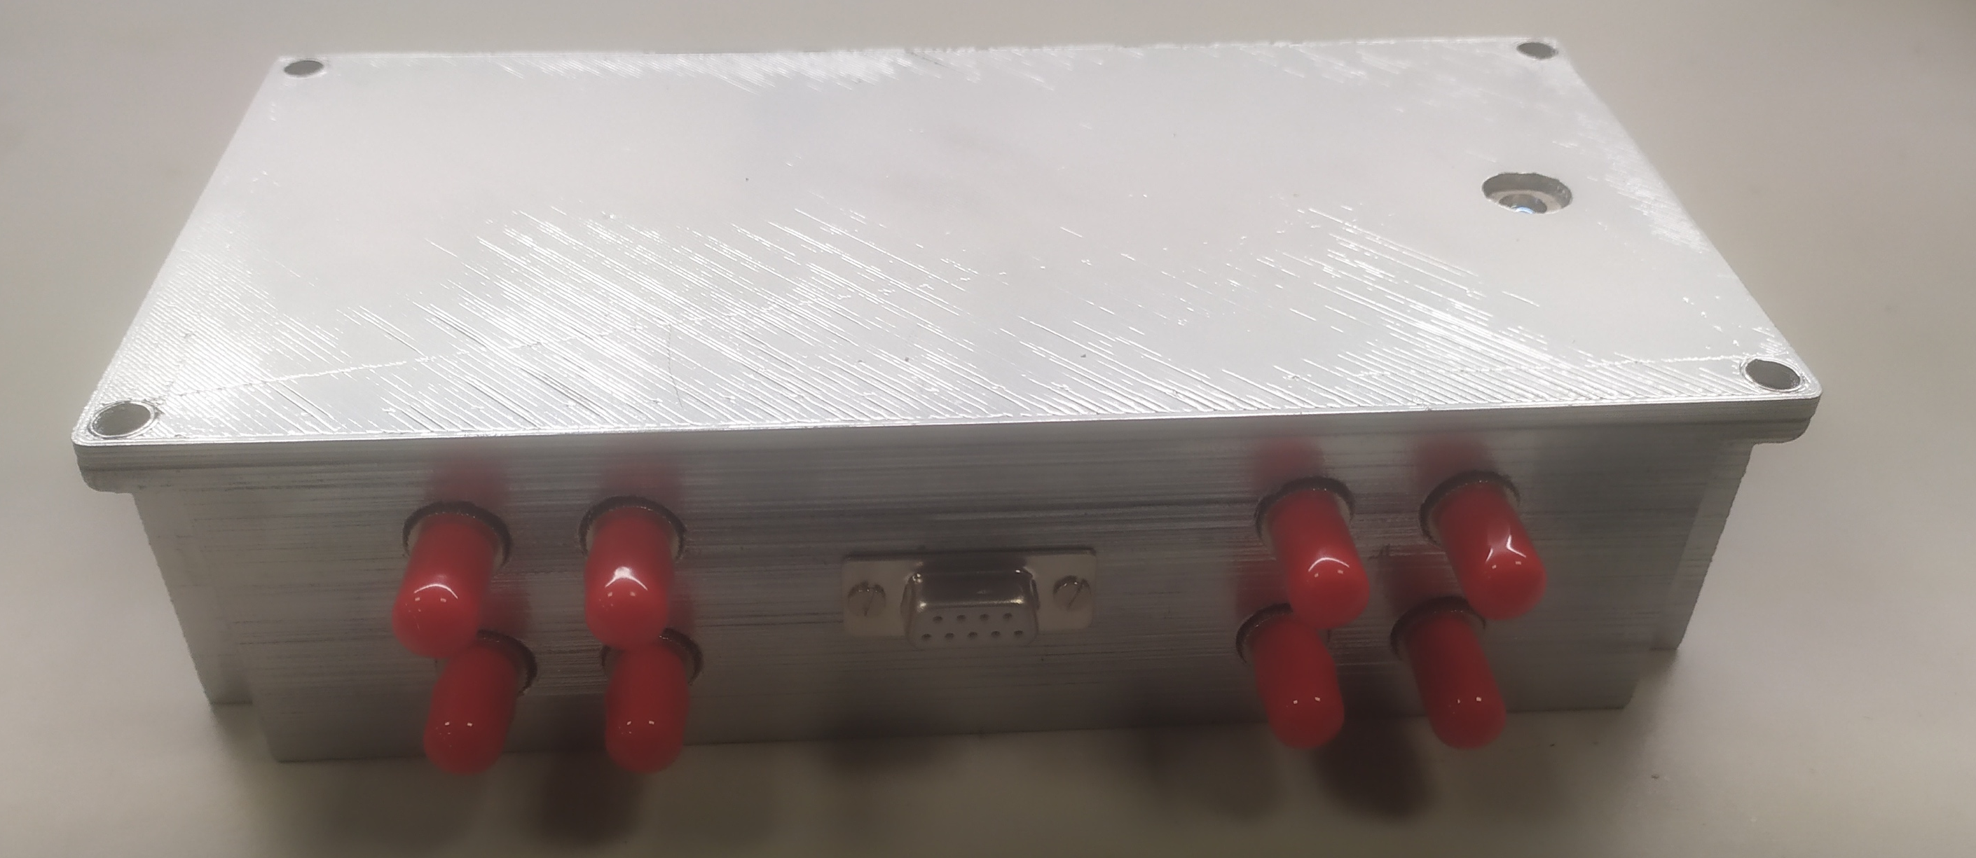
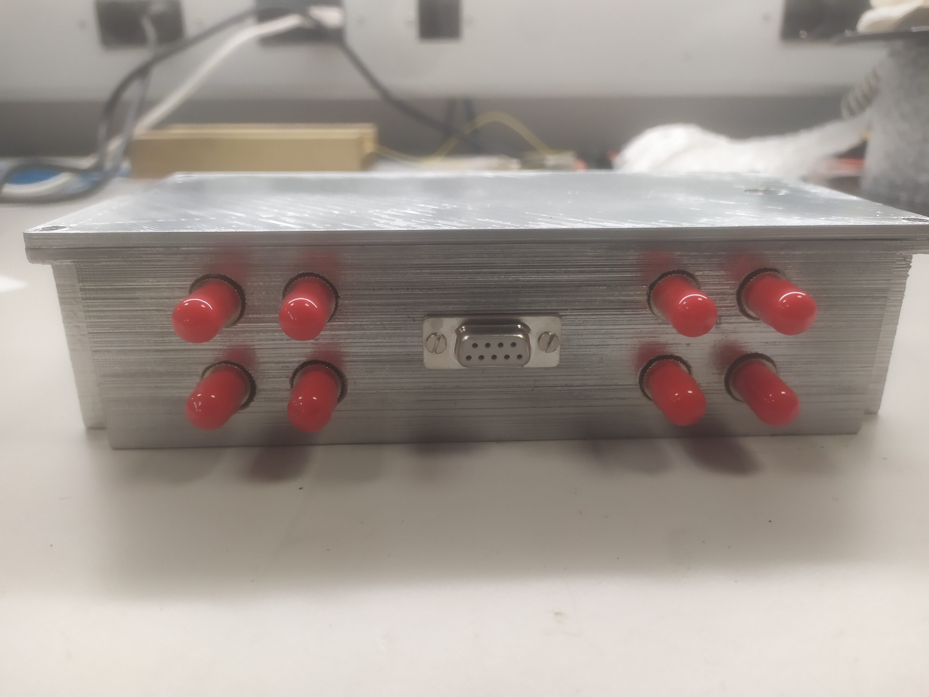
Plasmonic Propulsion: Prototype configuration

Slide 12
PM3: Publications
Journals:
S.Balestrieri, G.Zito, G.Coppola, M.Iodice “Plasmonic Nanostructures for Optically Induced Movement”, Frontiers of Nanotechnology (accepted).
S.Balestrieri, G.Zito, G.Coppola e M.Iodice; Plasmonic Nanodevice to generate force gradients to induce nanoparticles acceleration. Plasmonica (submitted).
Conferences:
S.Balestrieri, G.Zito, G.Coppola e M.Iodice; Plasmonic-based nanodevice to induce effective thrust on nanoparticle, ICOP 2022, Trento.
S.Balestrieri, G.Zito, G.Coppola e M.Iodice; Plasmonic Nanodevice to induce strong EM field gradient, Plasmonica Workshop, Torino (2022).
S.Balestrieri, G.Zito, E.Calloni, G.Coppola e M.Iodice; Plasmonic Propulsion, PhD Workshop (2021), Università di Napoli Federico II.

