Slide 1

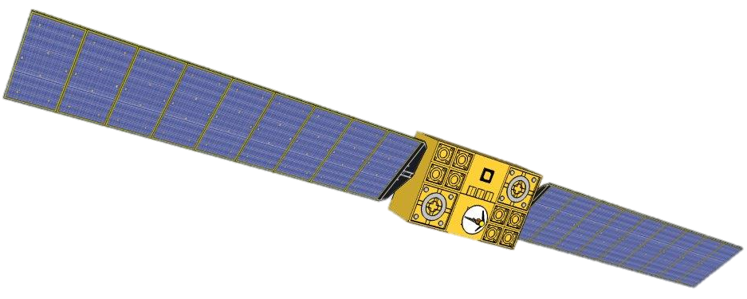
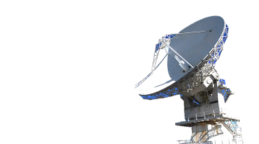
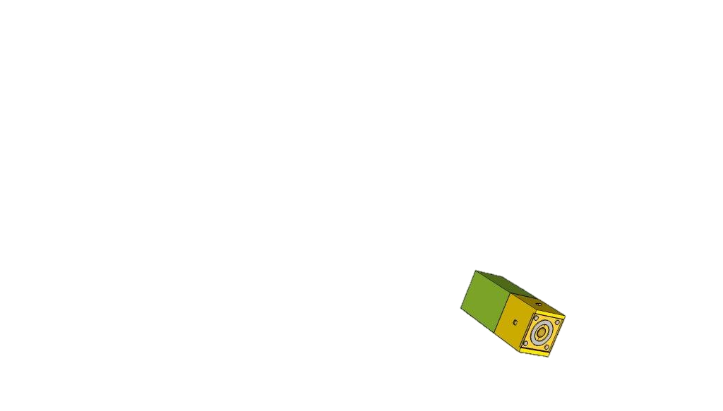

PM³
Piattaforma Modulare Multi-Missione
The Docking Module
Speaker:
Eng. Pasolini Pietro
Notes:
1

Slide 2
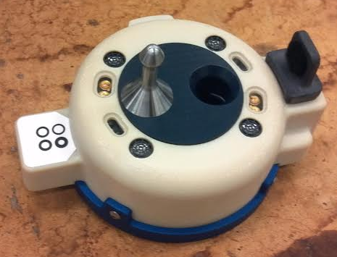
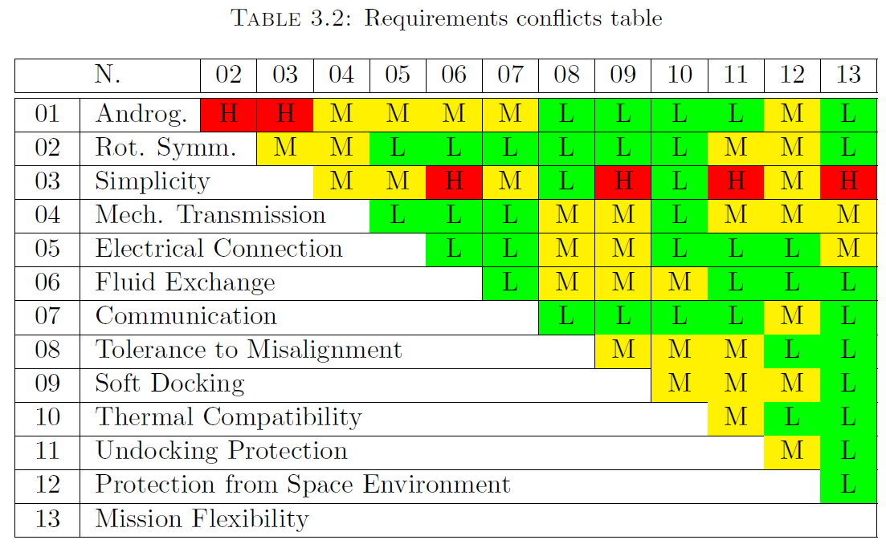
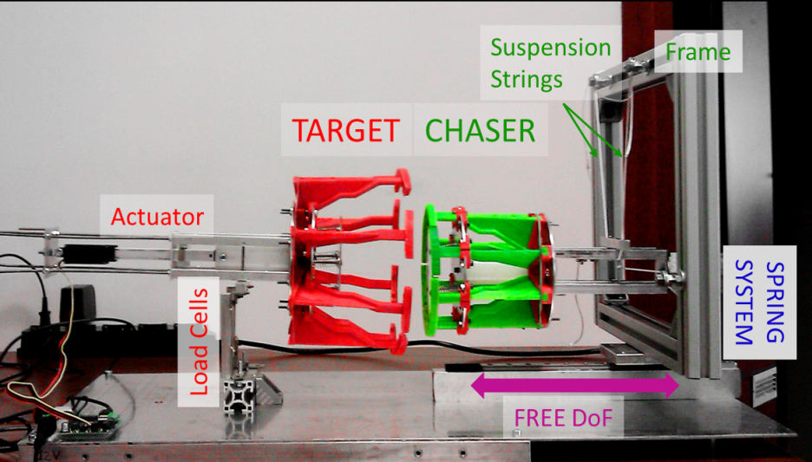
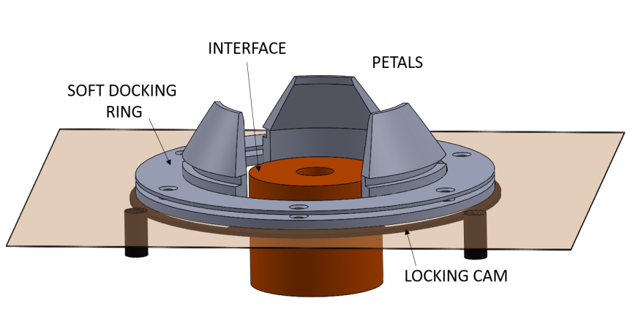
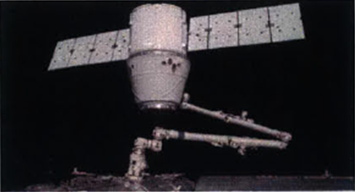
The Docking Module
Literature review
Gendered
Standard Docking Port Requirements conflict table
Androgynous
Complex
Central interface for fluid/electrical exchange

Slide 3
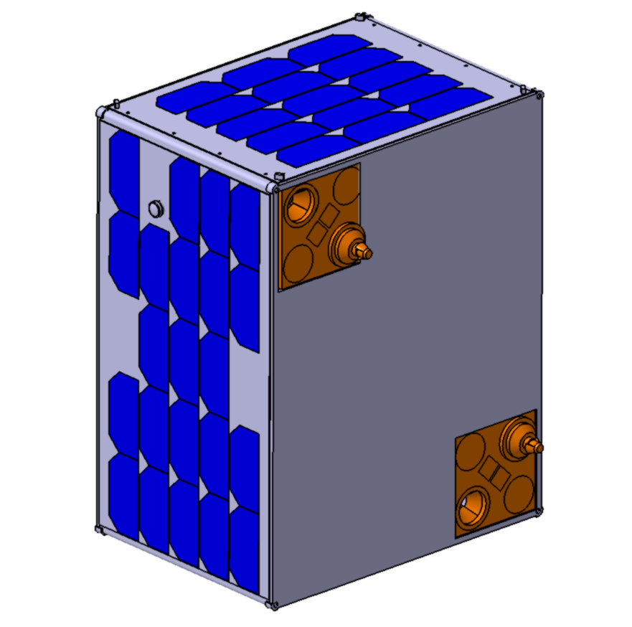
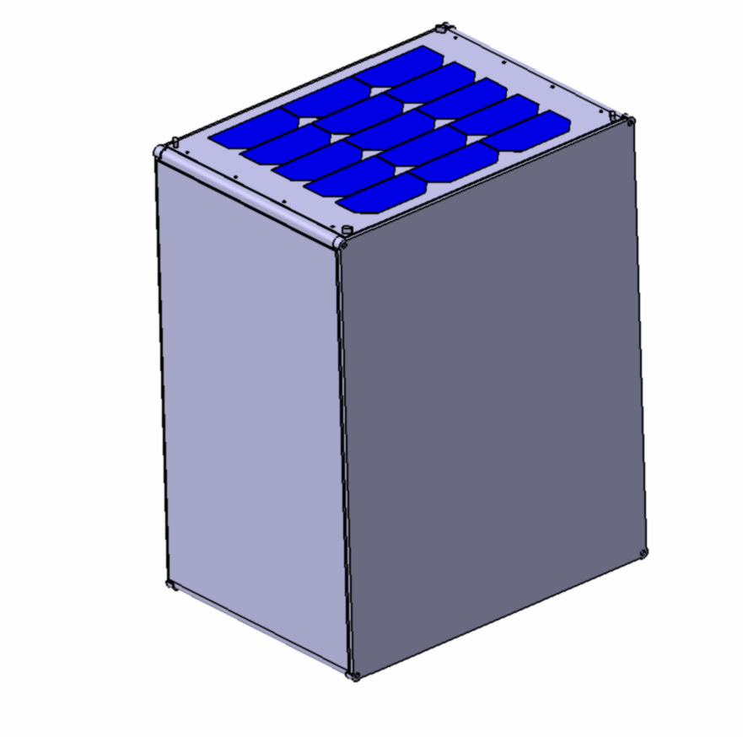
The Docking Module
The PM3 Docking Module
BUS
CARRIER
Docking Port Location
PM3 Docking Approach in BUS / CARRIER Configuration

Slide 4
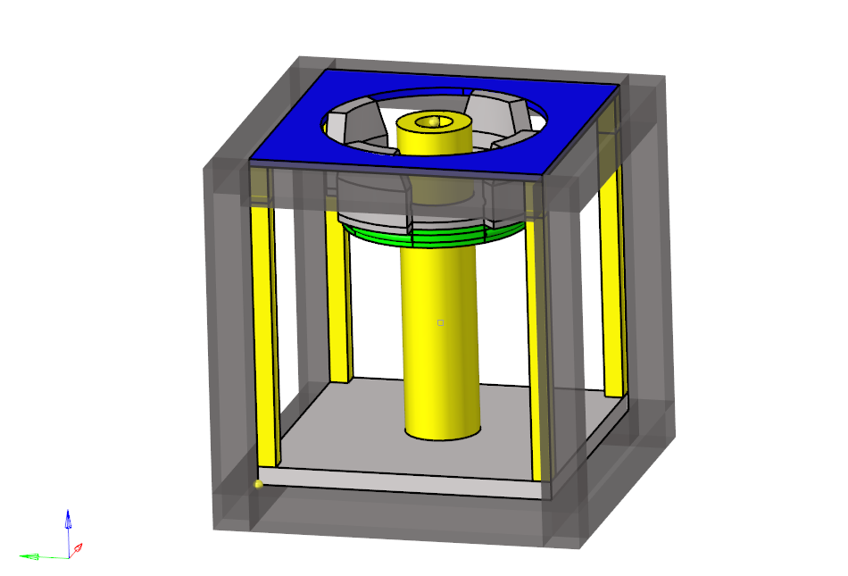
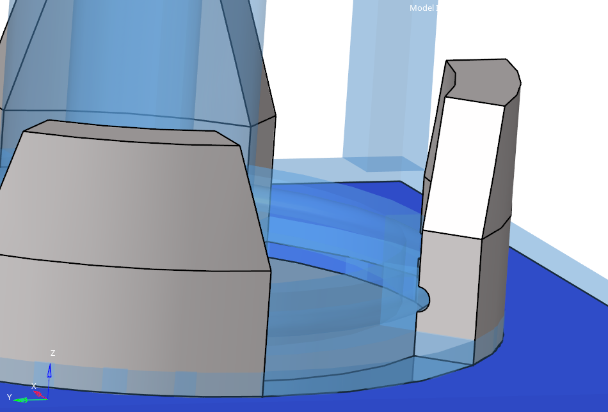
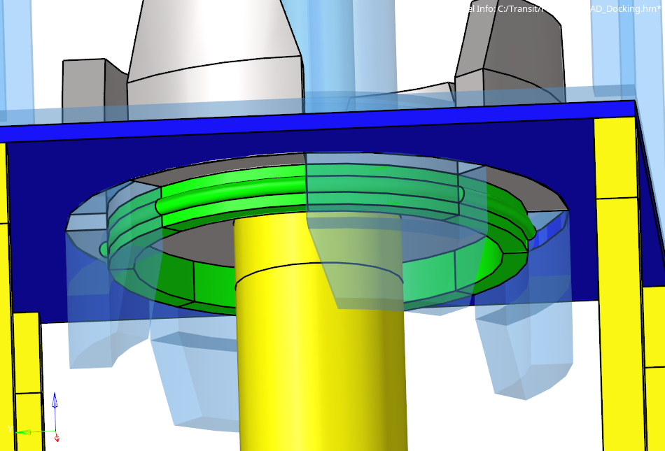
The Docking Module
First Approach – The “Claws” design
PRO | CONS
Androgyny | High Influence Area
Partial Rot. Symmetry | High Complexity
Central Interface for Fuid/Mass Exchange
Claws
CubeSat structure
Interface
Rotating CAM
Rotating CAM
Slot
Locking CAM

Slide 5
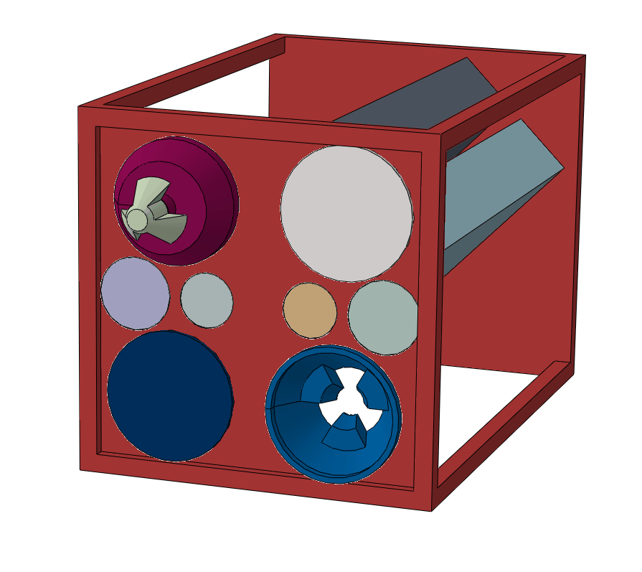
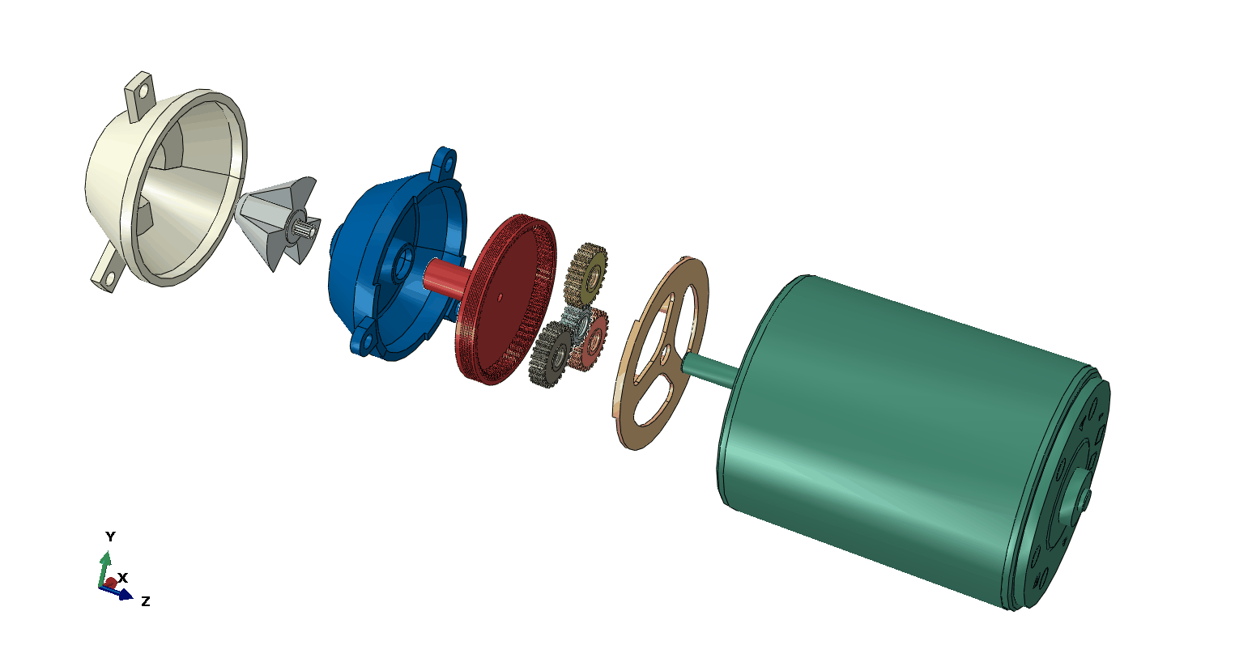
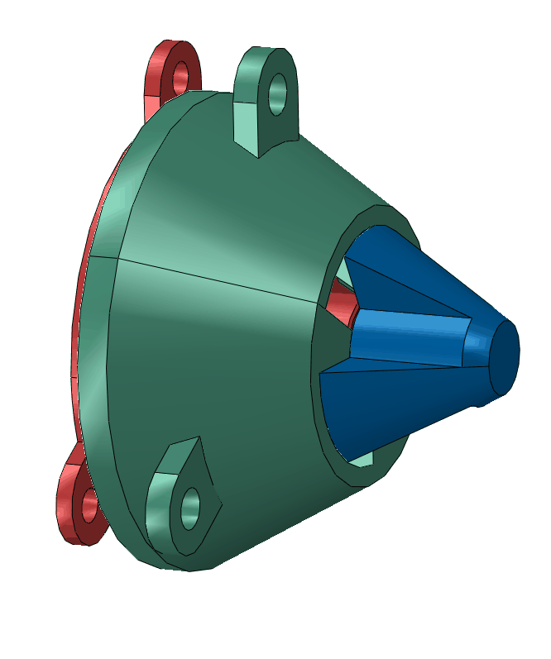
The Docking Module
The Probe/Drogue Principle
PRO | CONS
Both Androgynous/Gendered configurations | Low Axial Tolerance
Low Influence Area | High Complexity of Planetary Gearbox
High Angular tolerance | High Stepper Motor Weight
Drogue
Probe assy
Planetary Gearbox
Stepper Motor

Slide 6
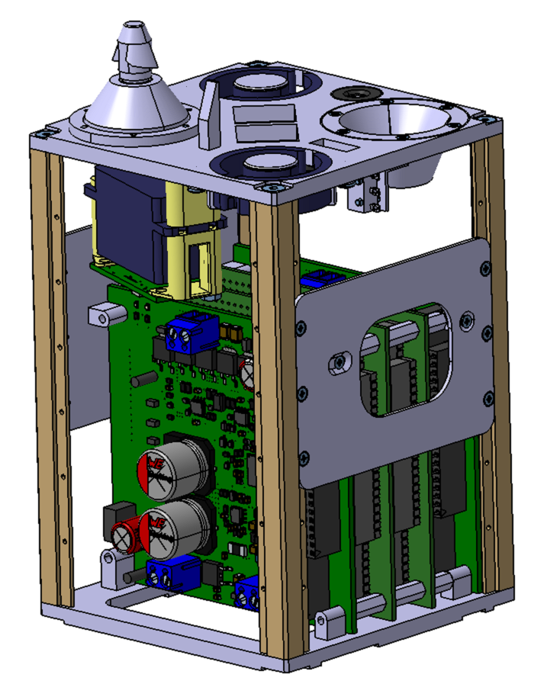
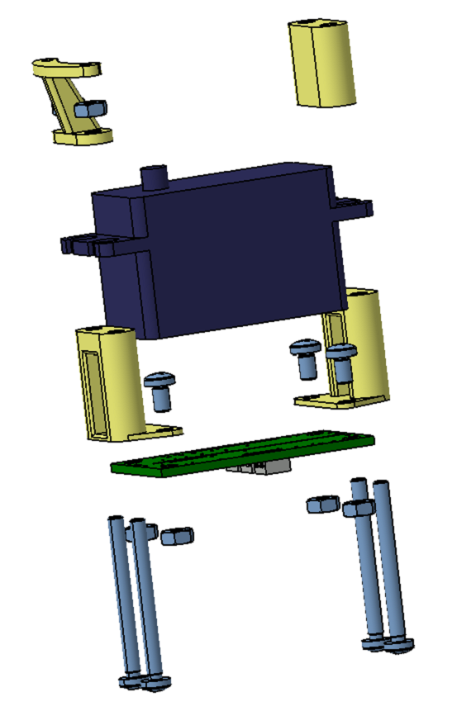
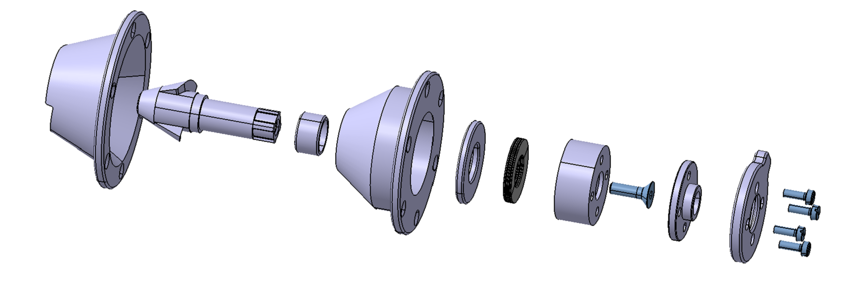
The Docking Module
The Probe/Drogue CAD Improvements
Drogue
Pin
Servo Motor Assy
Probe assy
Support Flange
Cup Spring
Bushing
Rotating Cam
Radial Bearing
Improvements
Reduced Motor Weight
Improved Probe Design with elicoidal shape
No Addictional Gear Box needed
Bushing
Servo Horn
Control Board

Slide 7
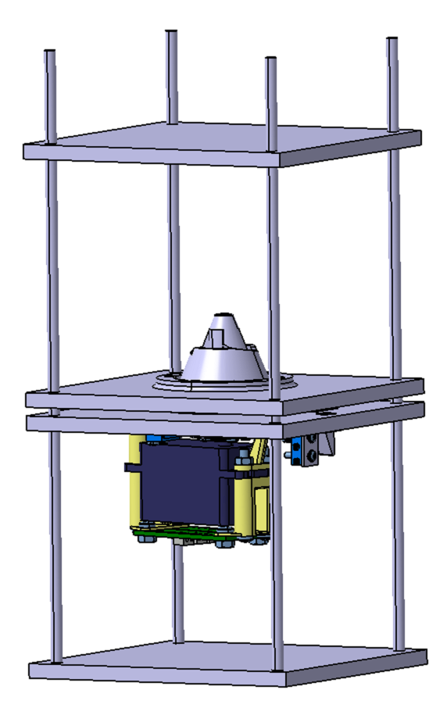
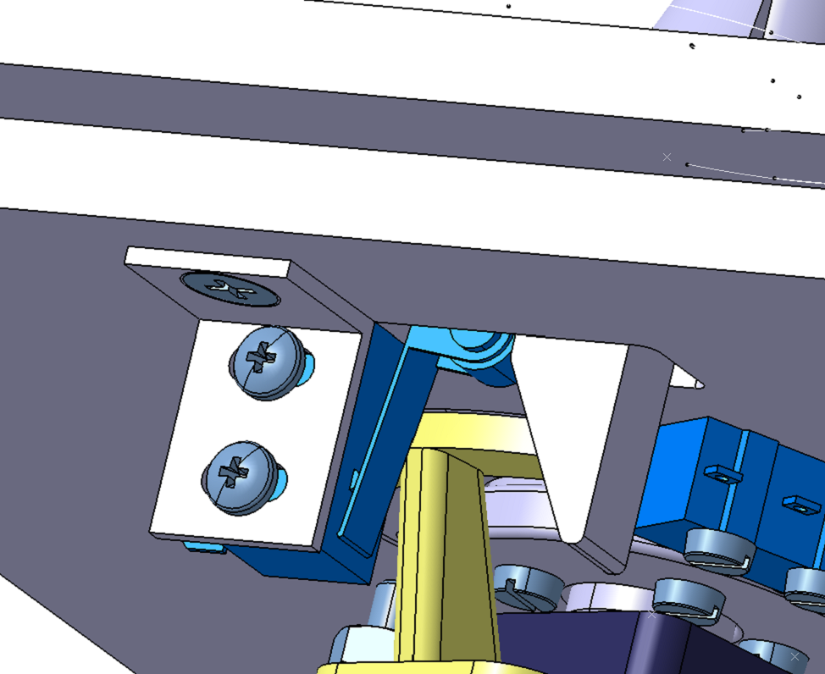
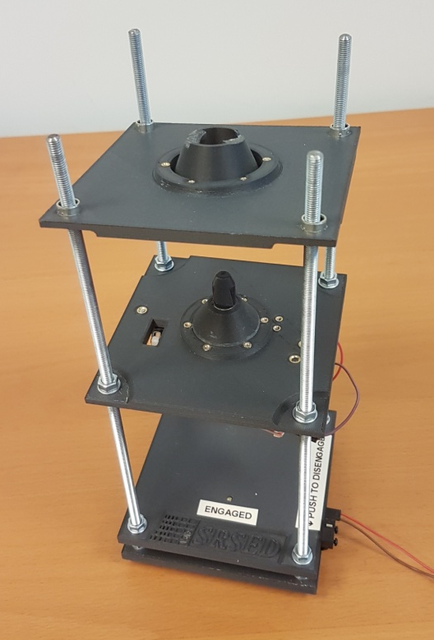
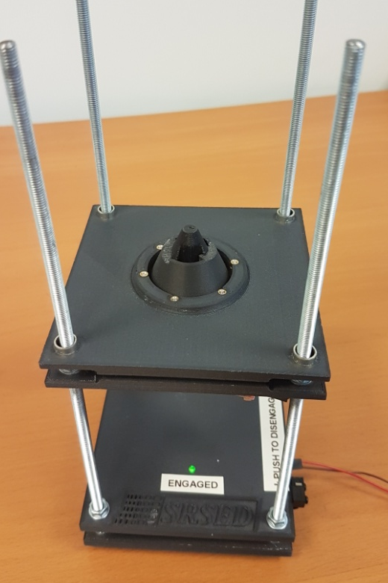
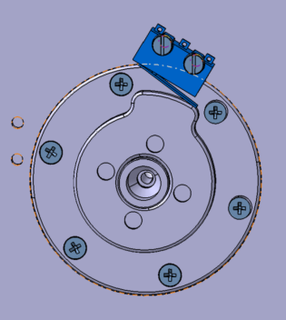
The Docking Module
The Engineering Module (from CAD to Prototype)
CAD Model
Prototype Model 3D Printed
EM Before Docking
EM Docked
Axial Miroswitch
Rotational Miroswitch

Slide 8
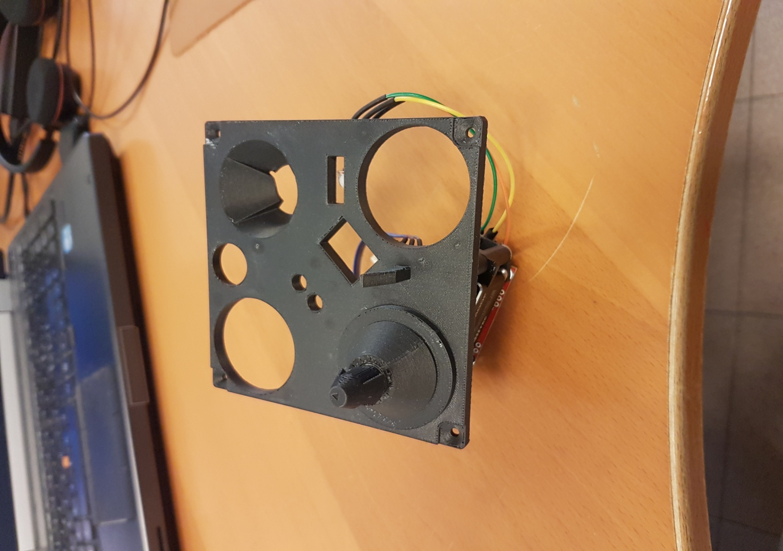
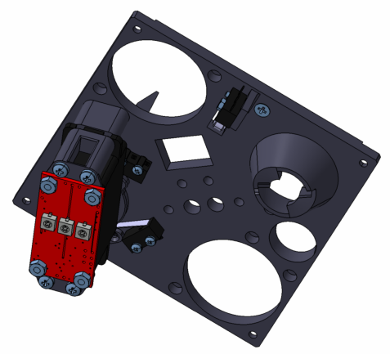
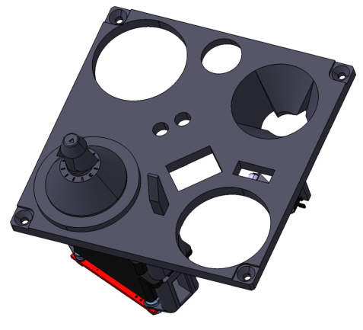
The Docking Module
The Docking Mechanism Prototype (ABS CF-10 3D Printed)
CAD Model
Prototype Model 3D Printed
Bottom view
Top view
Interface plate 3D printed as a single component

Slide 9
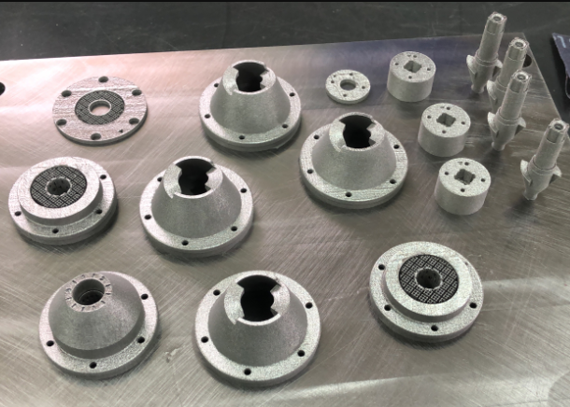
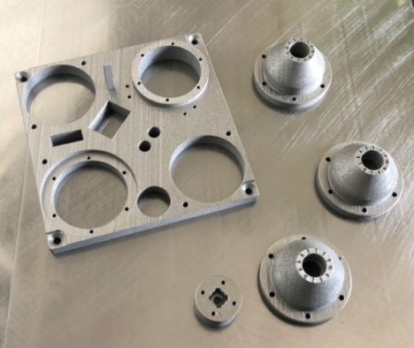
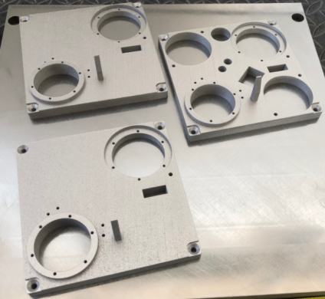
The Docking Module
The Docking Mechanism Prototype for PM3 integration (Titanium 3D Printed)
CAD Model
Probe/Drogue components 3D printed as separate components

Slide 10
The Docking Module
Conclusions
As per PM3 design guidelines, the docking mechanism has achieved following goals:
Wide range of applicability: due to the small dimensions suitable for medium, small and micro satellite market, such as CubeSat standard.
High flexibility: thanks to the possibility of assembling the mechanism in both “Androgynous” or “Gendered” configurations
Low weight: thanks to the simple design and the use of low-weight servo motors
Low costs and rapid prototyping/integration: thanks to the possibility of using the Additive Manufacturing technology, it is possible of reducing the lead time of integration and testing into new satellite configurations, and also reducing the number of components.

Slide 11
Thanks for your Attention
SRS Engineering Design PM3 Project Team
Team Manager Engineer: Gramiccia Luciano
Project Engineer: Pasolini Pietro
Project Engineer: D’Aniello Giovanni
Design Engineer: Gramiccia Andrea
Design Engineer: Mangialento Alessandra

